Slide 1
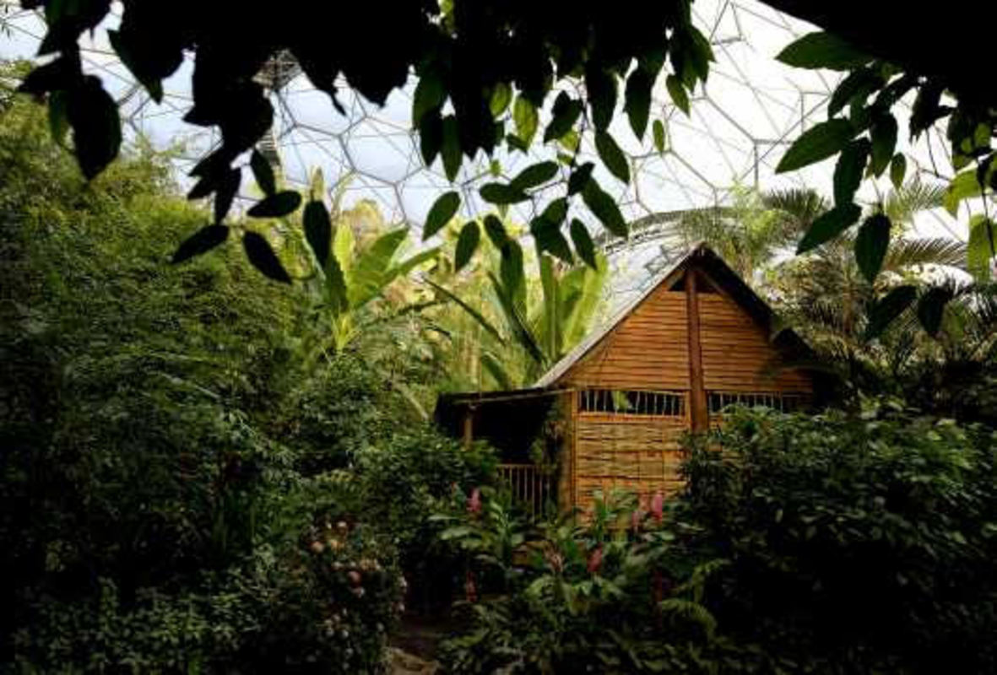
Wednesday 17th June 2020
Sentence challenge!
Using the passive and active voice.
Eg. Passive voice
The house, which is hidden deep in the Malaysian Rainforest, is surrounded by luscious, green plants.
Active voice
Luscious, green plants surround the house, which is hidden deep in the Malaysian Rainforest.
Write three of your own sentences about this image using the passive and active voice.
Sick sentences!
These sentences are sick and need your help to get better!
There is a house.
It is in the rainforest.
There are plants.
There are flowers.

Slide 2
To answer the final two questions in the leaver’s book
Today we are going to answer the final two questions needed for the Year 6 book. However, Year 5 you can play along as well and think about your answers to this questions:
When I am older I am most likely to be…
What do you think you will be when you grown up – I have put some suggestions on the next page but you may have a different one. Write down the question and add your answer and keep it safe.

Slide 3
Examples:
Working in a school
Astronaut
Physicist
Mathematician
Politician
Shopkeeper
Gardener
Electrician
Doctor
Artist
Traveller
Comedian
Baker/Chef
Musician
Magician
Personal trainer
Famous football/other sports player
Plumber
Nurse
Swimming instructor

Slide 4
What will you miss about Beechwood?
This final one is entirely up to you – it can be one thing you will miss or lots of things. You can write a short sentence or a larger paragraph. Are there particular people that you will miss – friends, staff?
Now is your chance to write about them all and tell us why you are going to miss them. On the next page I have given an example which might help to get you started. However, this is a very personal one so it is over to you. Keep your writing safe when you have completed it because we are going to bring it all together tomorrow.

Slide 5
Modelled example:
I am really going to miss a lot of things when I leave Beechwood: Miss Craig has been an amazing teacher so I will really miss her but I will also miss my prefect role and all the sports activities that we do. There are so many adults at school that have helped me particularly Miss Randy who has been a lot of fun this year. I have loved all the class assemblies and productions and would have loved to repeat last years sports day this year. I am sad that we didn’t get a final term at Beechwood because of Covid-19 but have lots of lovely memories and I will return to visit (when it is safe to do so!).

