Slide 1
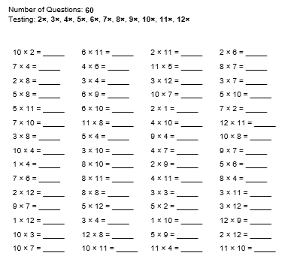
To revise previous learning on numbers to ten million
10.06.20
Mild
Choose a level:
Time how long it takes you to answer all the questions.
Make sure you check your answers with a calculator.

Slide 2
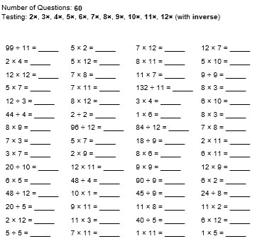
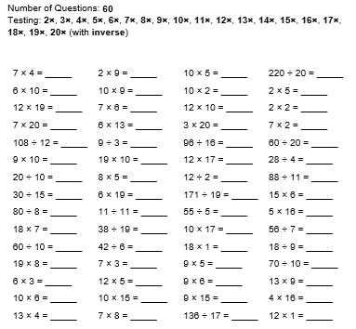
Hot
Spicy

Slide 3
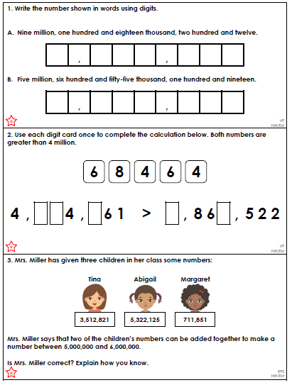
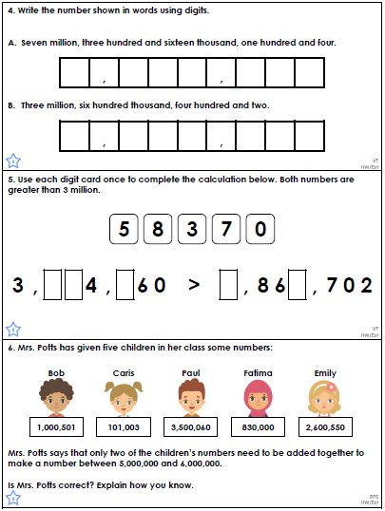
Mild
Hot

Slide 4
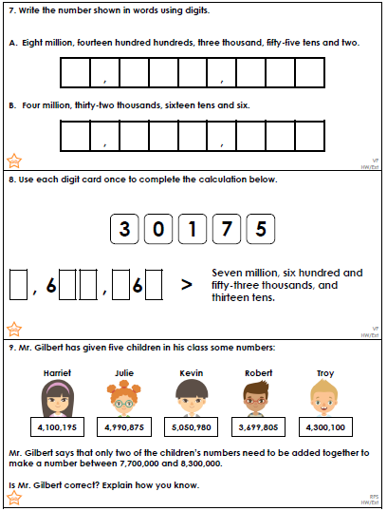
Spicy

Slide 5
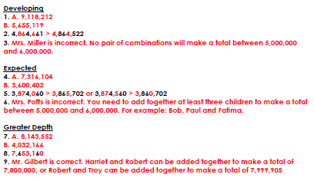
I would now like you to have a go at writing your own place value question (in the style of the questions you have just answered).
Can you get someone in your household to answer it? Then check their answer!

