Slide 1
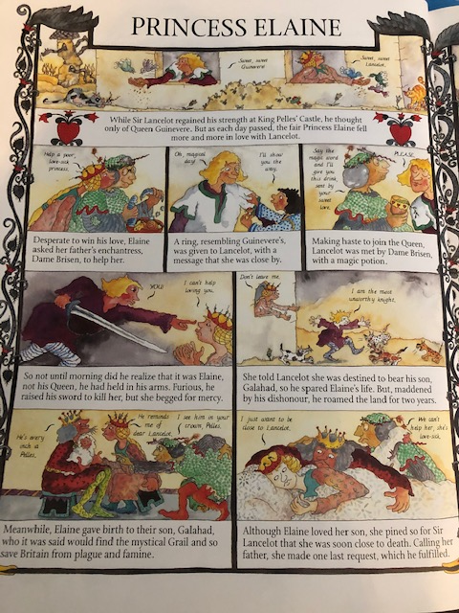
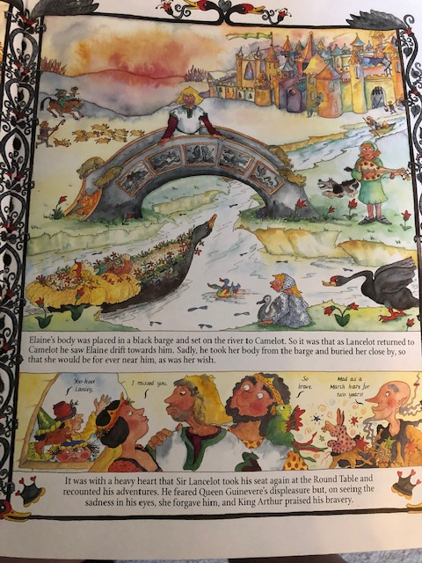
Notes:
Day 2-Vocabulary day! Read the chapter again. Are there any words you don’t understand?
Get a dictionary and try and find the words you don’t know – can you write down the definition for them?
Can you use any of the words in a sentence? Can you think of any ways to help you remember these words?

