Slide 1
Thursday 2nd July Around the World in 80 days!
Write these two sentences again, but as one sentence,
joining them with ‘and’.
Mum got a new car. I went in it.

Slide 2
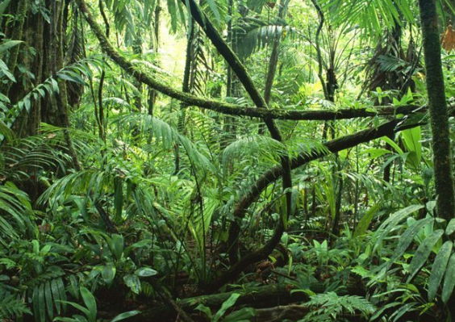
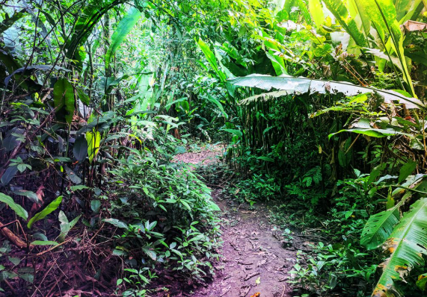
Yesterday we travelled down the Amazon River, today lets explore the rainforest.
The Amazon is the worlds biggest rain forest.
A rainforest is a thick, wet woodland that gets lots of rain all year.

Slide 3
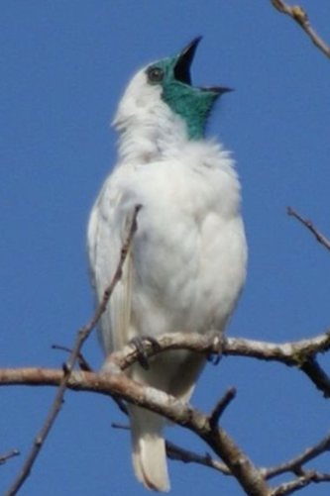
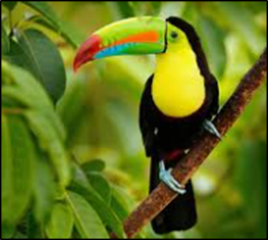
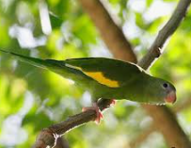
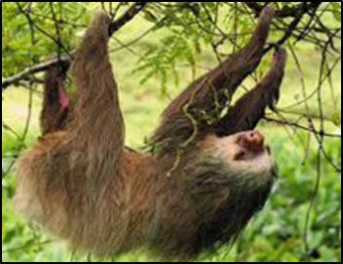
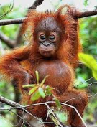
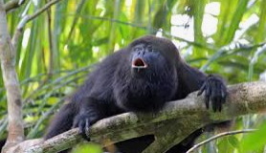
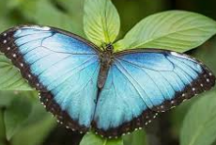
Let’s look up. Who lives in the tree tops?
It is very wet and windy up there.
Toucan
Bellbird
Parakeets
Sloth
Orangutan
Butterflies
Howler monkeys

Slide 4
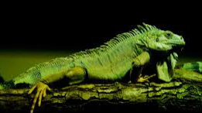
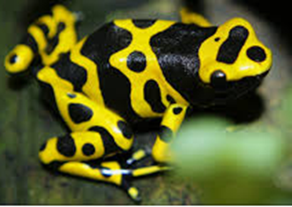
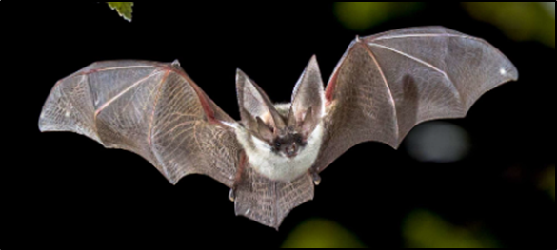
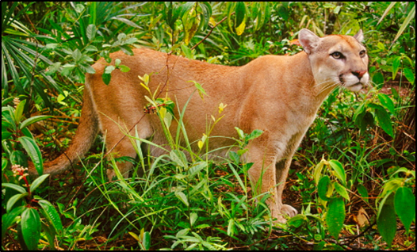
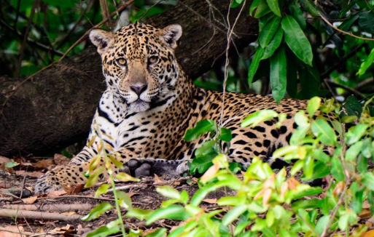
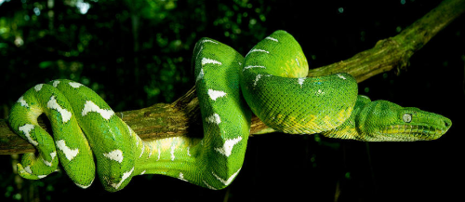
Who lives among the trees and in the bushes?
Iguana
Tree frogs
Bats
Puma
Jaguar
Snake

Slide 5
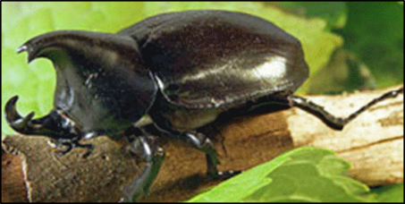
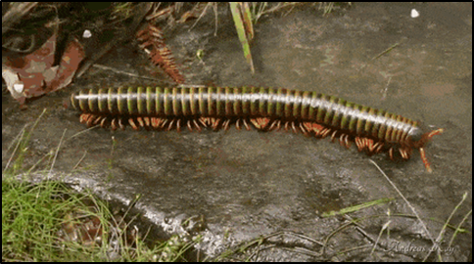
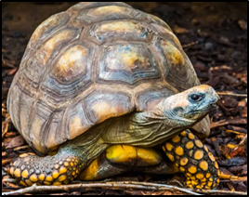
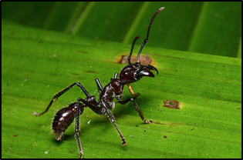
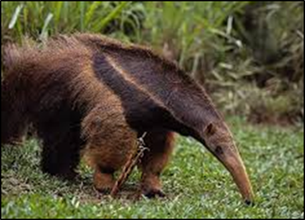
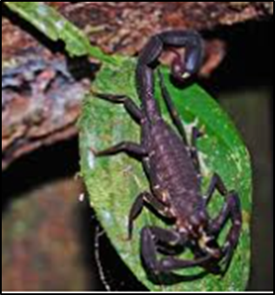
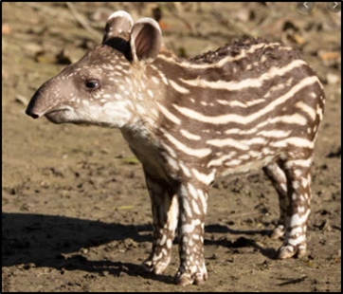
Now look down, who lives on the rainforest floor?
Rhinocerous Beetle
Millipede
Tortoise
Ants
Scorpion
Tapir
Ant Eater

Slide 6
Your writing task today is to draw a colourful picture of the rainforest, showing different animals you might see as you trek through. Use your phonics to label the animals. Don’t forget to send a photo of your picture in to Miss Pilbeam and Mrs Frain, we love to see your home learning.

