Slide 1
English
Thursday, July 16th 2020
LO: To plan a play script

Slide 2
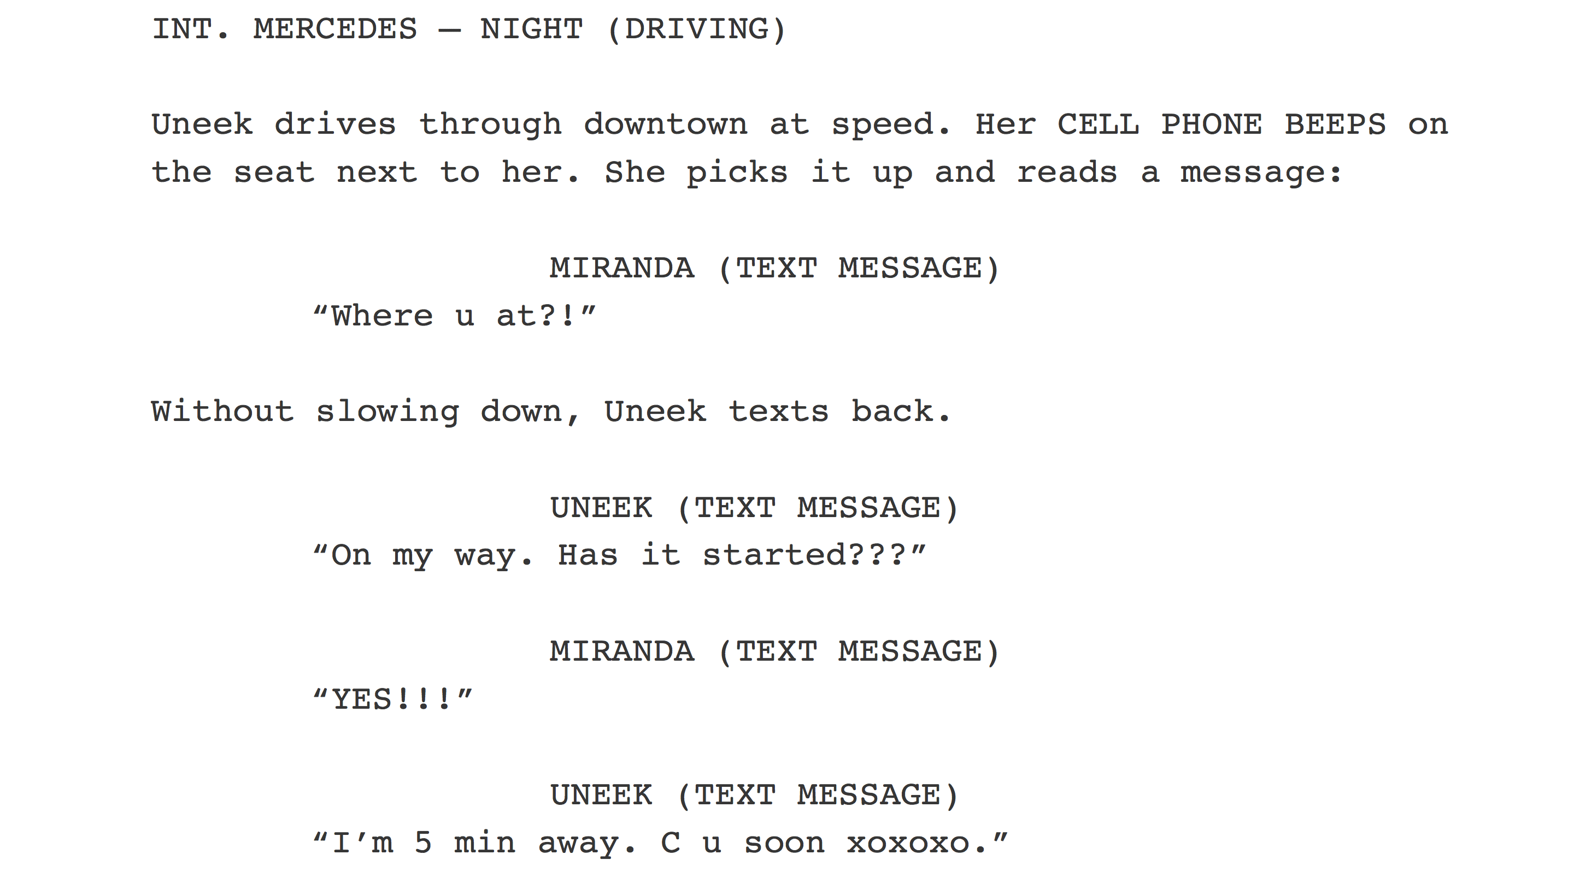
Write your planned script
TASK: Today we are going to write our scripts.
Remember to use all of the key features that we have learnt about and to organise your play by titling each scene.
Remember to be ambitious with your use of language and also punctuate your work with care.
Use the following Success Criteria for guidance….

Slide 3
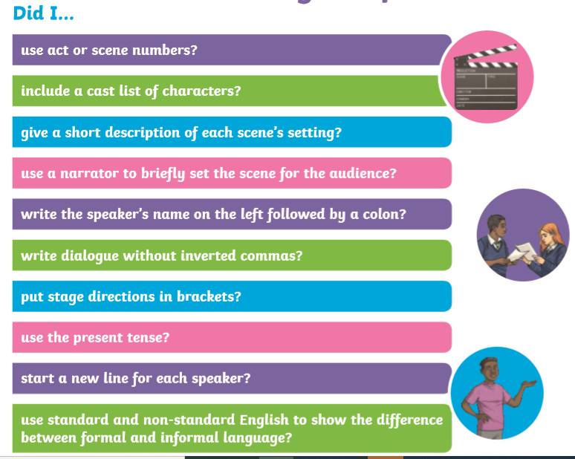

Slide 4
Scene 1 The opening and build up. The audience should find out about the problem.
What is the setting?
What will happen in this scene?
Scene 2 The climax. The problem should be faced and solved.
What is the setting?
What will happen in this scene?
Scene 3 The resolution. Show the audience how things have now changed for the characters.
What is the setting?
What will happen in this scene?

