Slide 1
Monday 6th July For the last 2 weeks, we will be recapping some of the maths we have learnt and practicing some important skills you will need in Year 2.
Mrs Frain and Miss Pilbeam hope you have lots of fun visiting your new year 2 classes this week!

Slide 2
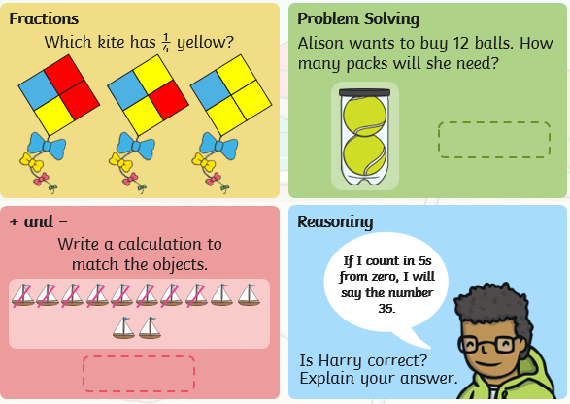
Monday 6th July
Starter:

Slide 3
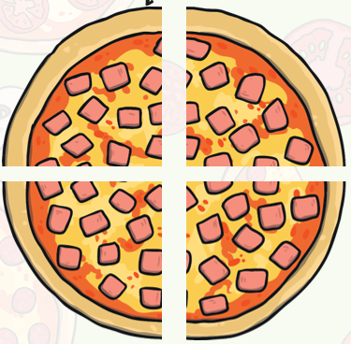
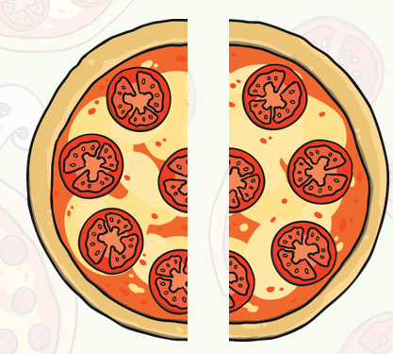
Fractions.
Do you remember when we learnt about fractions, we looked at the words half and quarter.
1
Quarter. This means something is split into 4 pieces.
4
1
Each of these pieces is 1 quarter. If you had 2 pieces you would have 2 quarters.
If you had 3 pieces, how many quarters would you have?
Half. This means that something is split into 2 pieces and a half is one piece.
2

Slide 4
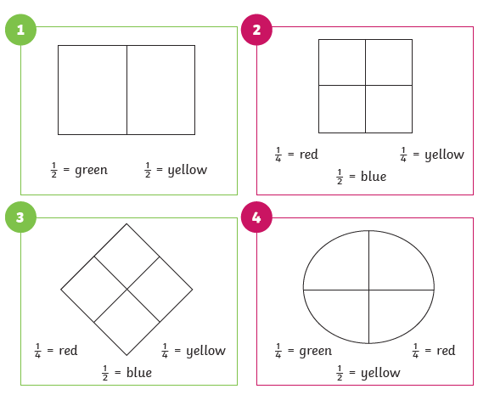
Can you copy these shapes and the lines.
Look at the fractions to know how much of the shape to colour in and what colour to use.
Answers are on the last slide.

Slide 5
Can you solve todays problem?
How did you work it out?
What does the answer tell you?

Slide 6
Answers
The line is now 4cm long.
We now know that half of 8 is 4.

