Slide 1
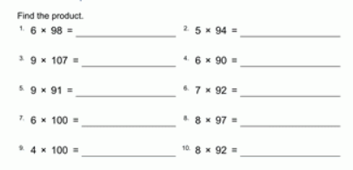
REVISION Multiplication Check your answers on a calculator.
Wednesday 15th July 2020
Mental multiplication.
See how fast you can work out the answers.
Use your rounding off skills!

Slide 2
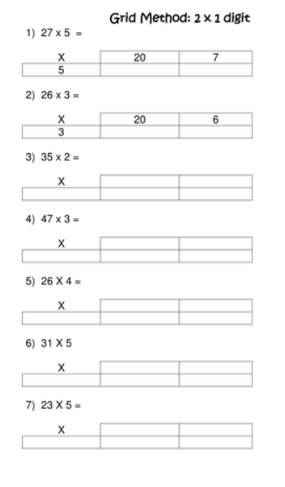
Use the grid method to solve the problems
Write out the multiplication problem and calculate the answers.
189 x 5 =
284 x 6 =
314 x 9 =
467 x 8 =
293 x 7 =

Slide 3
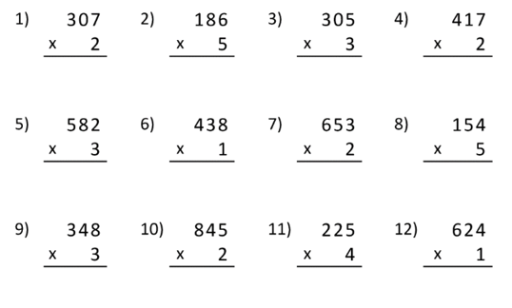
Multiplying decimals
Column multiplication
This is also called short multiplication
Multiply by 10 and 100
1.2 x 10 =
5.4 x 100 =
2.3 x 10 =
1.7 x 100 =
12 x 10 =
0.4 x 10 =
10 x 100 =
1.8 x 10 =
30 x 10 =
4.1 x 100 =
Remember that 1 multiplied by 10 is 10.
1.2 is 1 whole and 2 tenths multiplied by 10.
So it will become 12.
If you understand this, you can move 1 step to the left, across the decimal point when you multiply by 10.
And 2 steps if you multiply by 100

Slide 4
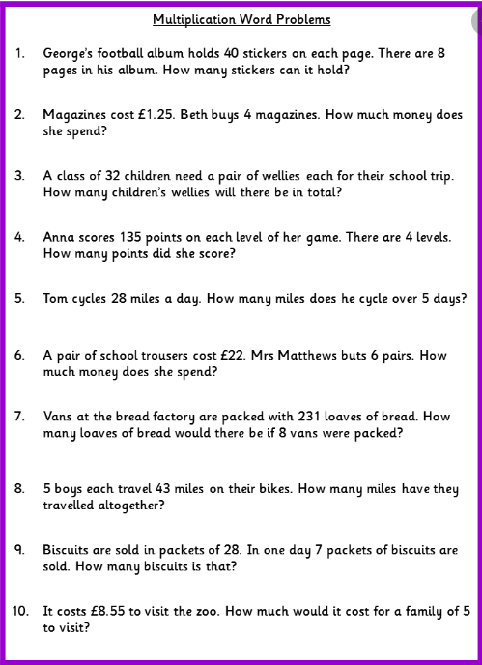
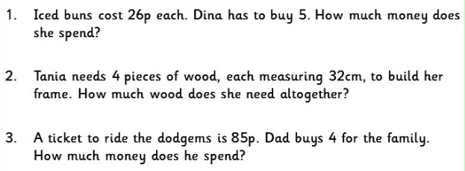
Word problems
Read the problems carefully.

