Slide 1
6.7.20 Make equal groups
This week we are going to be recapping division.
It might be helpful to use resources like pennies, lego pieces or pencils to share in equal groups.
Visit https://www.bbc.co.uk/bitesize/articles/zfxtnrd
Watch the videos.
Notes:
Notes and guidance
Children divide by making equal groups. They then count on to find the total number of groups.
They need to do this using concrete manipulative sand pictorially in a variety of contexts.
They need to recognise the link between division, multiplication and repeated addition.

Slide 2
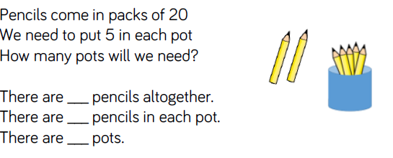
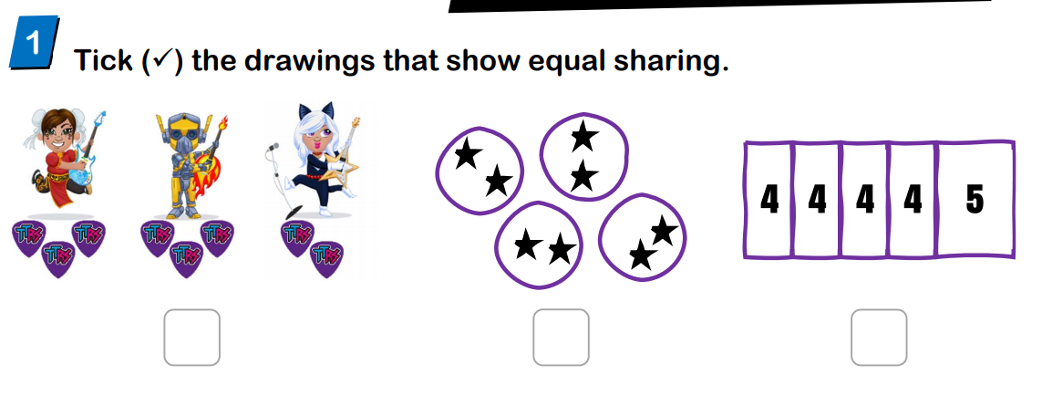
6.7.20 Make equal groups
Mild
Notes:
Mathematical Talk
How many do you have to begin with?
How many are in each group?
How many groups do you have?
How long should your number line be?
What will you count up in?
There are _____ groups of _____ which make ______

Slide 3
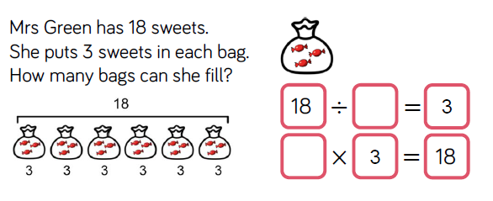
6.7.20 Make equal groups
Hot

Slide 4
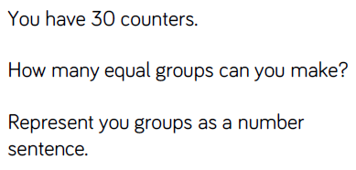
6.7.20 Make equal groups
Spicy
Notes:
Answers
1.
10 groups of 3
3 groups of 10
6 groups of 5
5 groups of 6
2 groups of 15
15 groups of 2
2.
30 ÷ 5 = 6
25 ÷ 5 = 5
20 ÷ 5 = 4
15 ÷ 5 = 3

Slide 5
6.7.20 Make equal groups
Challenges!
1. I have 30p in my pocket in 5p coins. How many coins do I have?
2. Write the multiplication number sentences to describe this array
X X X
X X X
What do you notice?
3. Two friends share 12 sweets equally between them. How many do they each get? Write this as a division number sentence.
4. Make up two more sharing stories like this one.

