Slide 1
Reading
Friday, July 17th 2020
Reading Comprehension

Slide 2
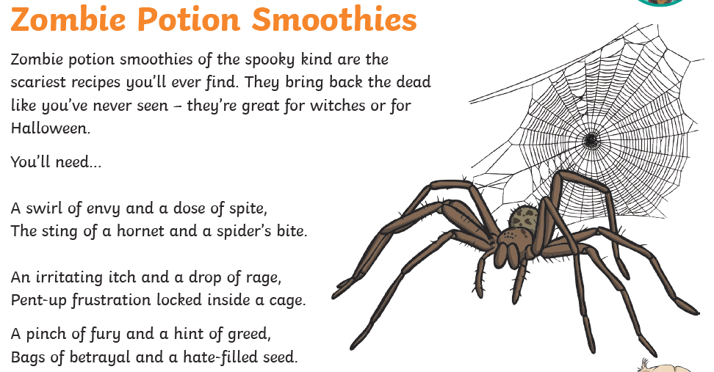

Slide 3
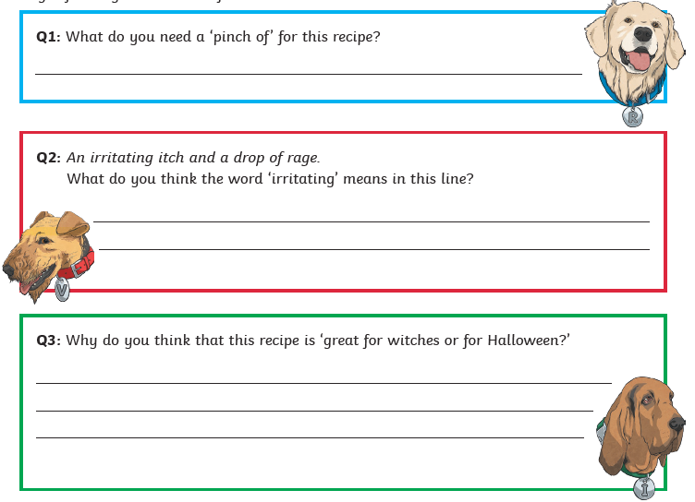

Slide 4
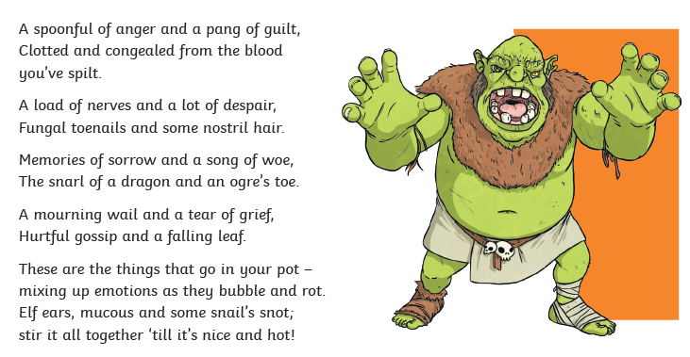

Slide 5
