Slide 1
16.7.20 Assessment
Today you will tackle paper 2 2018.
The first 5 questions are aural questions which will need to be read aloud by someone else (not the test taker)
Apologies that Tuesday’s questions did not have the aural questions
Try your best and have at go at every question
You have 1 hour to complete the paper

Slide 2
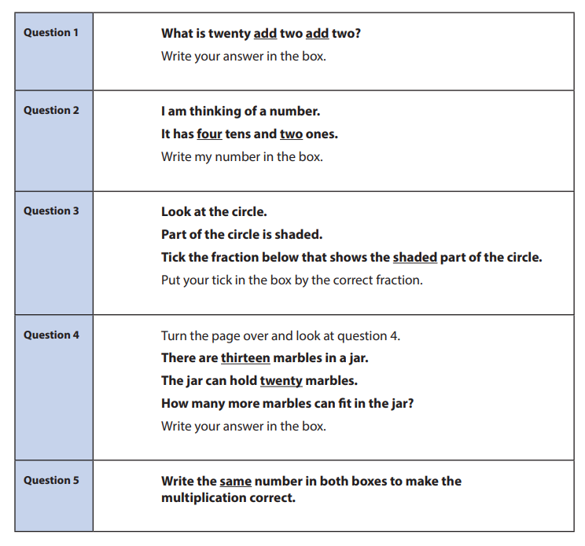
What to say at the start of the aural questions
Now I’m going to read aloud some questions for you to answer.
I’m going to read each question twice, with a short gap in between.
You need to listen very carefully when I read the questions to you.
You must work on your own and you must not call out the answers.

