Slide 1
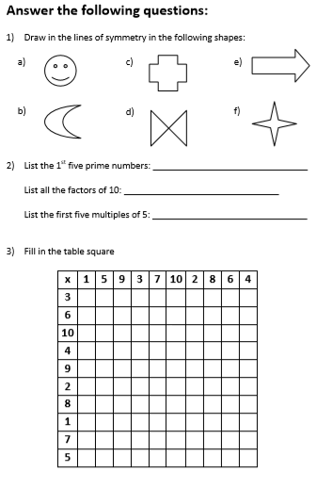
For the rest of the week we will supply questions from a year 5 revision pack 14.7.2020/ XIV.VII.MMXX
Use a calculator or the internet to check your work with the review package.

Slide 2
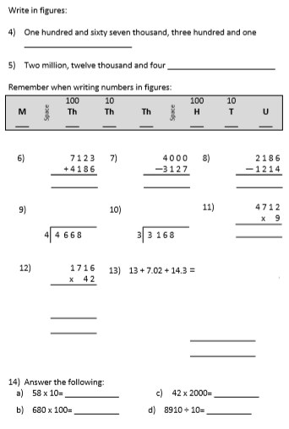

Slide 3
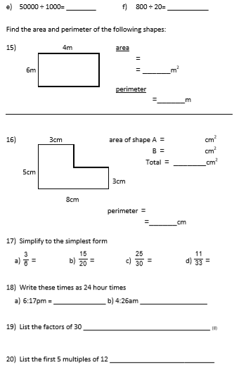

Slide 4
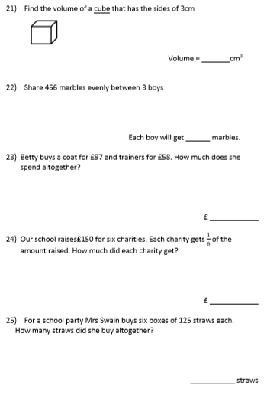

Slide 5
