Slide 1
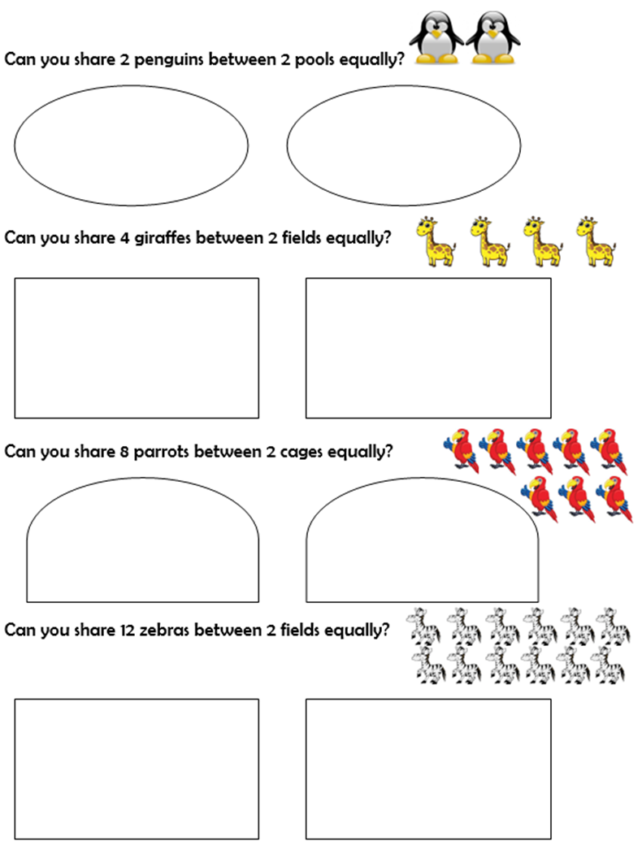
7.7.20 Divide by 2
Today we are going to divide by 2 or
share equally into 2 piles!
Practise on the questions to the right if you need to- use
resources (lego, pennies, straws)
Notes:
Notes and Guidance
Children should be secure with grouping and sharing. They will use this knowledge to help them divide by 2 They will be secure with representing division as an abstract number sentence using the division and equals symbol. Children should be able to count in 2s and know their 2 times table.

Slide 2
7.7.20 Divide by 2
Mild
Notes:
Mathematical Talk
What do you notice when you group these objects into twos? Is there a link between dividing by 2 and halving? What is different about sharing into two groups and grouping in twos? Can we write a multiplication sentence as well as a division sentence? What do you notice?

Slide 3
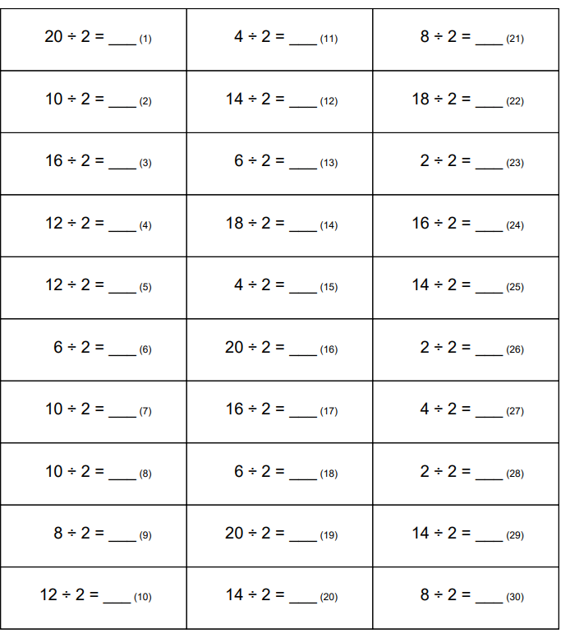
7.7.20 Divide by 2
Hot

Slide 4
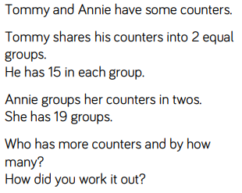
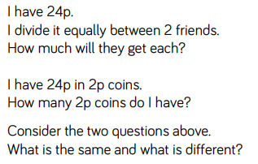
7.7.20 Divide by 2
Spicy
Notes:
Answers
The calculation is the same in both. In the first question we are sharing, whereas in the second question we are grouping.
Tommy has 30 counters. Annie has 38 counters. Annie has 8 more. Children could have compared 15 and 19 and realised they could have done 2 × 4

Slide 5
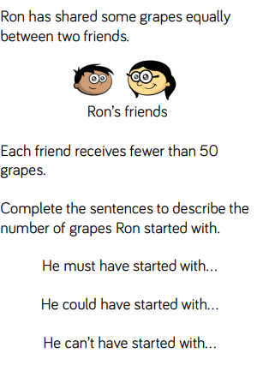
7.7.20 Divide by 2
Challenge
Notes:
Answers
Possible answer: He must have started with an even number of grapes. He could have started with 40 grapes. He can’t have started with 100 grapes.

