Slide 1
Activities

Slide 2
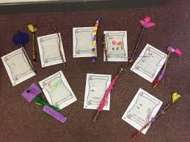
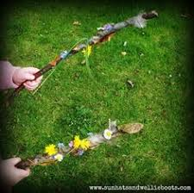
Make a wand and cast a spell
PD
Uses simple tools to effect changes to materials.
Handles tools, objects, construction and malleable materials safely and with
increasing control.
Shows a preference for a dominant hand.
EAD
Manipulates materials to achieve a planned effect.
Constructs with a purpose in mind, using a variety of resources.
Introduces a storyline or narrative into their play
Literacy
Describes main story settings, events and principal characters.
Using a stick and coloured ribbon create a magic wand which will help you cast spells.
Can your child think about how they are going to make their wand? What do they want to add to it? How will it stick? What might they need help with?
Can your child create a spell?
Can the draw it? Can they tell you about it?
Can they label their drawing with initial sounds?

Slide 3
Dough Disco
Make quick playdough following this quick and easy recipe:
https://theimaginationtree.com/best-ever-no-cook-play-dough-recipe/
Make this with your child. Discuss capacity and weight to consolidate last weeks learning.
Once made, enjoy dough disco sessions:
https://www.youtube.com/watch?v=i-IfzeG1aC4
Links: Maths and Physical development.
Potions lab
Can you create a potions lab for your child to explore and role play?
Links: EAD using imagination, Communication language and literacy.
Baking
Can you follow the instructions to create Witches/ Wizards Hat biscuits.
Have a spooky tea party ☺
Links: EAD Physical Development and Communication and Language.
(Recipe card on website).
Size ordering
Practice cutting skills (fine motor skills) and consolidating understanding of size by cutting and ordering the magical muddle characters from biggest to smallest/ smallest to biggest.
Make it easier by providing less to order and harder by adding more of the cut outs to order.

